Slide 1
Topic 1: Fundamentals of Logical Algebra
CST205 Digital Logic

Slide 2
The Karnaugh Map
A Karnaugh map (also called K-map) provides a systematic method for simplifying Boolean expressions and will produce the simplest SOP and POS expression possible, known as the minimum expression.
K-map can be used for expressions with 2, 3, 4 or 5 variables, hence we have 2-variable, 3-variable, 4-variable or 5-variable K-maps.
But we will focus on the 3-variable K-map and the 4-variable K-map.

Slide 3
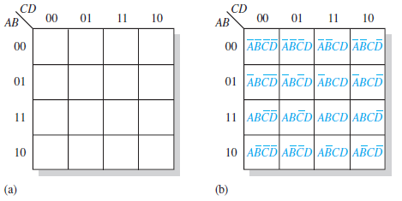
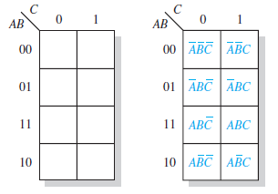
The 3-variable and 4-variable K-map
The 4-variable K-map
The 3-variable K-map

Slide 4
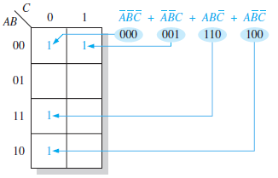
3-variable map: Mapping a standard SOP expression
Each product term is mapped to a cell in the K-map and labeled with logic 1.
For example, X = A’B’C’ + A’B’C + ABC’ + AB’C’

Slide 5
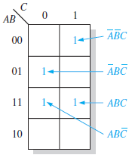

Example
Map the following standard SOP expression on a K-map: A’B’C + A’BC’ + ABC’ + ABC

Slide 6

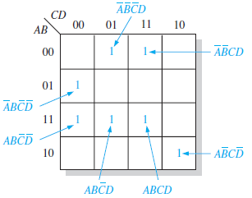
4-variable map: Mapping a standard SOP expression
Map the following standard SOP expression on a K-map:
A’B’CD + A’BC’D’ + ABC’D + ABCD + ABC’D’ + A’B’C’D + AB’CD’

Slide 7
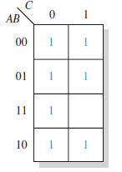
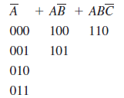
Mapping a nonstandard SOP expression (3-variable K-map)
Map the following SOP expression on a K-map:
A’ + AB’ + ABC’
First, expand the terms. Then, map the product terms

Slide 8
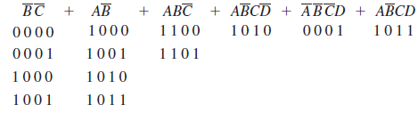
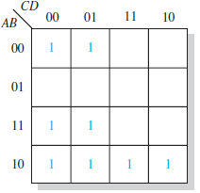
Mapping a nonstandard SOP expression (4-variable K-map)
Map the following SOP expression on a K-map:
B’C’ + AB’ + ABC’ + AB’CD’ + A’B’C’D + AB’CD

Slide 9
K-map Simplification of SOP Expression
After an SOP expression has been mapped, a minimum SOP expression is obtained by grouping the 1s and determining the minimum SOP expression from the map.
In grouping the 1’s, use the following rules:
A group must contain either 1, 2, 4, 8 or 16 cells. In the case of a 3-variable map, 2³ = 8 cells s the maximum group.

Slide 10
K-map Simplification of SOP Expression (Continued)
Each cell in a group must be adjacent to one or more cells in that same group, but all cells in the group do not have to be adjacent to each other.
Always include the largest possible number of 1s in a group in accordance with rule 1.
Each 1 on the map must be included in at least one group. The 1s in a group can be included in another group as long as the overlapping groups include noncommons 1s.

Slide 11
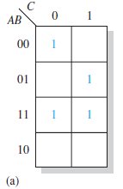
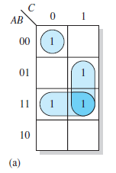
Examples of grouping of 1s in K-maps
Grouping of 1s

Slide 12
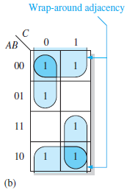
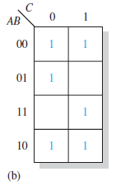
Examples of grouping of 1s in K-maps (Continued)
Group the 1s

Slide 13
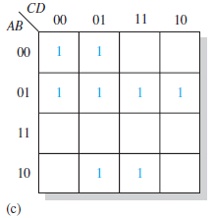
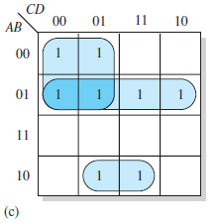
Examples of grouping of 1s in K-maps (Continued)
Group
the 1s

Slide 14
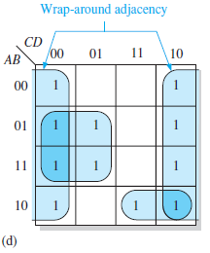
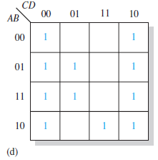
Examples of grouping of 1s in K-maps (Continued)
Group
the 1s

Slide 15
Determining minimum SOP from the K-map
Apply the following rules to find the minimum product terms and the minimum SOP expression:
Each group of cells containing 1s creates one product term composed of all variables that occur in only one form (either uncomplemented or complemented) within the group. Variables that occur both uncomplemented and complemented within the group are eliminated.

Slide 16
Determining minimum SOP from the K-map (Continued)
Determine the minimum product term for each group.
When all minimum product terms are derived from the K-map, they are summed to form the minimum SOP expression.

Slide 17
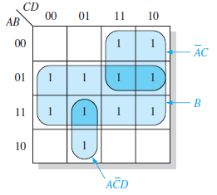
Example
Determine the product terms of the K-map and write the resulting minimum SOP expression.
X = A’C + B + AC’D

Slide 18
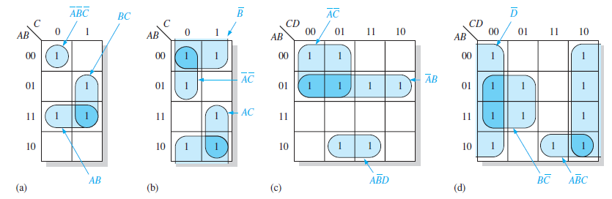
More examples
A’B’C’+BC+AB
A’C’+A’B+AB’D
B’+A’C’+AC
BC’+AB’C+D’

Slide 19
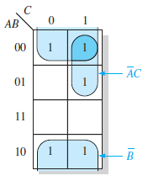
Another example
Use K-map to minimize the following standard SOP expression: AB’C+A’BC+A’B’C+A’B’C’+AB’C’.
Minimized expression:
B’ + A’C

Slide 20
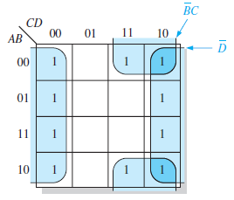
Example of 4-variable K-map minimization
Use K-map to minimize the following SOP expression: B’C’D’+A’BC’D’+ABC’D’+A’B’CD+AB’CD+A’B’CD’+A’BCD’+ABCD’+AB’CD”
Minimized expression:
B’C + D’

Slide 21
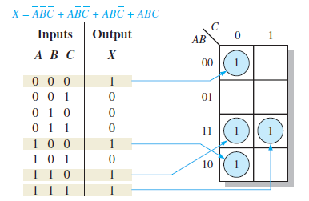
Mapping directly from a truth table to a K-map

Slide 22
Don’t Care Conditions and K-maps
Don’t care conditions are cells that can be 0 or 1 on the K-map. It does not matter because it does not affect the overall function of the logic circuit.
In the K-map, don’t care condition is marked with an X in the cell.
When grouping the 1s, the Xs can be treated as 1s to make a larger grouping or as 0s if they cannot be used to advantage.

Slide 23
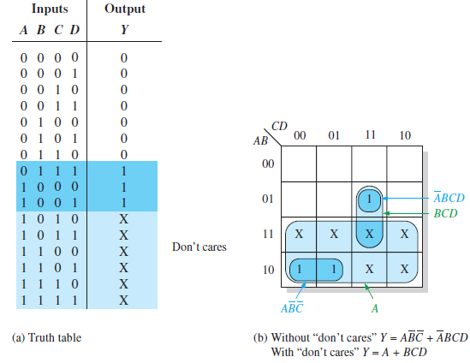
Example of don’t care conditions

Slide 24
Karnaugh Map POS Minimization
Mapping a standard POS expression
For a POS expression, a 0 is placed on the K-map for each sum term in the expression.
Each 0 is placed in a cell corresponding to the value of a sum term.
When a POS expression is completely mapped, there will be a number of 0s on the K-map equal to the number of sum terms in the standard SOP expression.
The cells that do not have 0 are the cells for which the expression is 1.

Slide 25
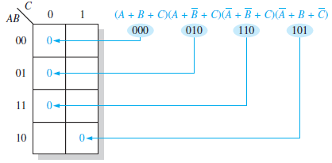
Example of mapping a standard POS expression

Slide 26
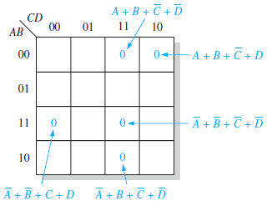
Another example
Map the following standard POS expression on a K-map.
(A’+B’+C+D)(A’+B+C’+D’)(A+B+C’+D)(A’+B’+C’+D’)(A+B+C’+D’)

Slide 27
K-map simplification of POS expressions
The process of minimizing a POS expression is basically the same as for an SOP expression except that you group 0s to produce minimum sum terms instead of grouping 1s to produce minimum product terms.
The rules for grouping the 0s are the same as those of grouping the 1s.

Slide 28
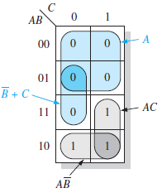
Example of K-map minimization of POS expression
Use a K-map to minimize the following standard POS expression.
(A+B+C)(A+B+C’)(A+B’+C)(A+B’+C’)(A’+B’+C)
Minimized expression:
A (B’ + C)

Slide 29
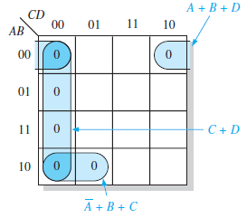
Another Example of K-map minimization of POS expression
Use a K-map to minimize the following standard POS expression.
(B+C+D)(A+B+C’+D)(A’+B+C+D’)(A+B’+C+D)(A’+B’+C+D)
Minimized expression:(A+B+D)(C+D)(A’+B+C)

Slide 30
Converting between POS and SOP using K-map
When a POS expression is mapped, it can be easily converted to the equivalent SOP form directly from the K-map.
Also, given a mapped SOP expression, an equivalent POS expression can be derived directly from the map.

Slide 31
Example of converting POS expression to SOP expression
Using a K-map, convert the following POS expression into a minimum POS expression, a standard SOP expression and a minimum SOP expression.
(A’+B’+C+D)(A+B’+C+D)(A+B+C+D’)(A+B+C’+D’)
(A’+B+C+D’)(A+B+C’+D)

Slide 32
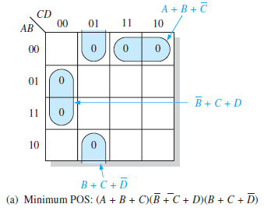
Solution (minimum POS expr.)

Slide 33
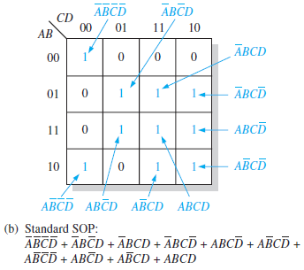
Solution (standard SOP)

Slide 34
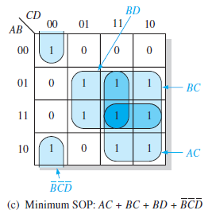
Solution (minimum SOP expr.)

Slide 35
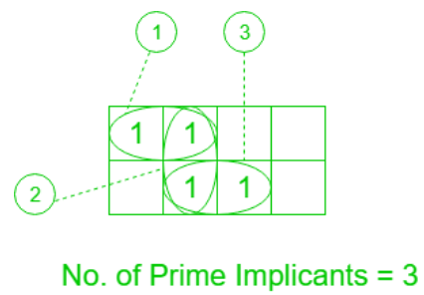
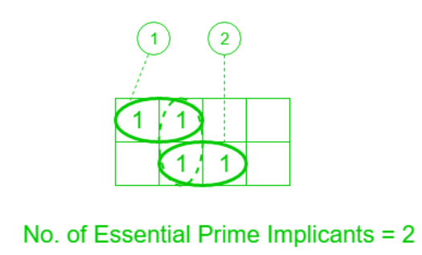
Implicants, Prime implicants and Essential Prime implicants
Implicants: An implicant is a product/minterm term in Sum of Products (SOP) or sum/maxterm term in Product of Sums (POS) of a Boolean function.
Prime Implicants: A group of squares or rectangles made up of a bunch of adjacent minterms which is allowed by the definition of K-Map are called prime implicants(PI) i.e. all possible groups formed in K-Map.
Essential Prime Implicants: These are those subcubes(groups) that cover at least one minterm that can’t be covered by any other prime implicant. Essential prime implicants(EPI) are those prime implicants that always appear in the final solution.

Slide 36
Summary
Numbering systems
Binary, Hexadecimal, Octal
Conversion, Arithmetic operations
Binary Code
BCD, Gray code
Conversion
Axiom of logical algebra
Different laws for addition and multiplication
DeMorgan’s theorem

Slide 37
Summary (Continued)
Minterm, maxterm
SOP, POS
Canonical forms
Truth table
Don’t care conditions
Simplification of logic functions
Karnaugh maps (3 variables and 4 variables)
SOP and POS

